Slide 1

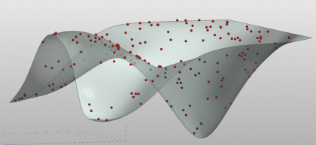
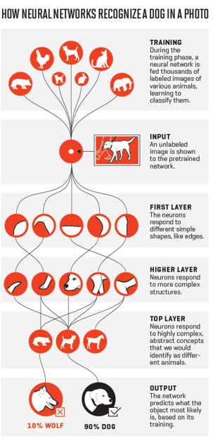
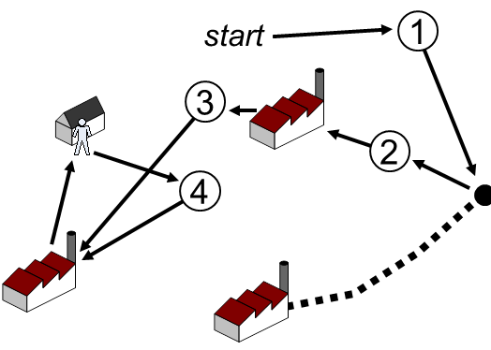
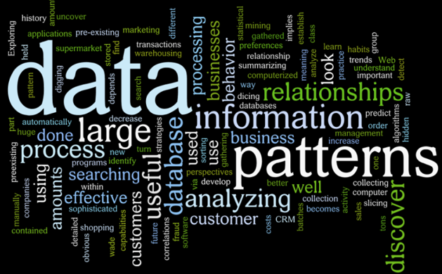

Slide 2
Basic Machine learning Methods (1)
Dimension reduction
Fengling Chen
2021.06.09

Slide 3
Outline
The general concept of machine learning
Dimension reduction
PCA & tSNE & UMAP
Recommendation
Notes:
PCA/tSNE/HMM/SVM
1.可以学习到机器学习的基本概念和分类，当自己遇到某些问题的时候能想到使用机器学习
2.两个最常用的降维方法原理，如何正确的解读相关的数据，不至于过度解读

Slide 4

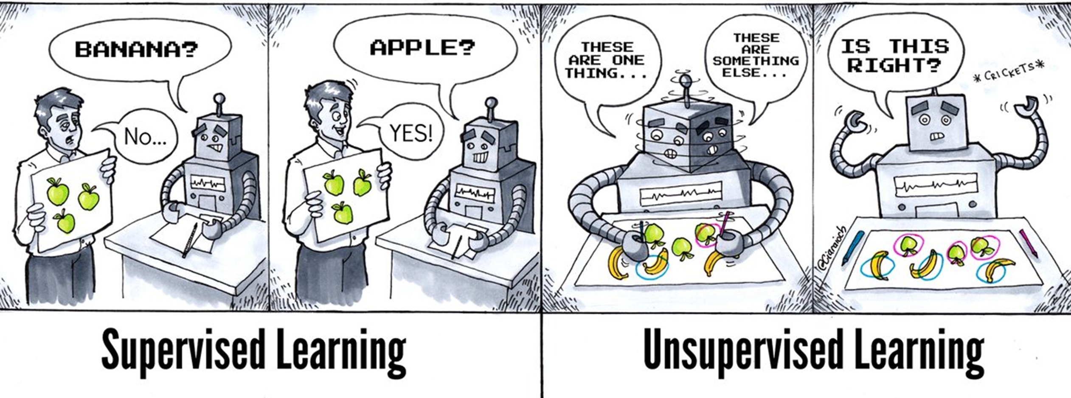
Supervised and unsupervised learning
（X,Y）
（X）

Slide 5
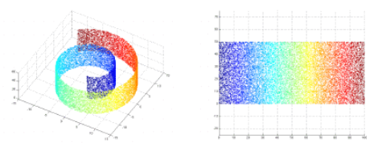

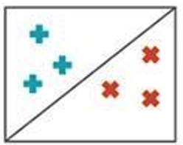
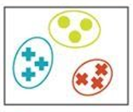
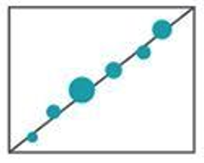
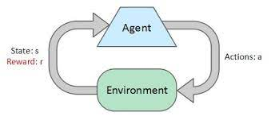
Basic tasks of machine learning

Slide 6
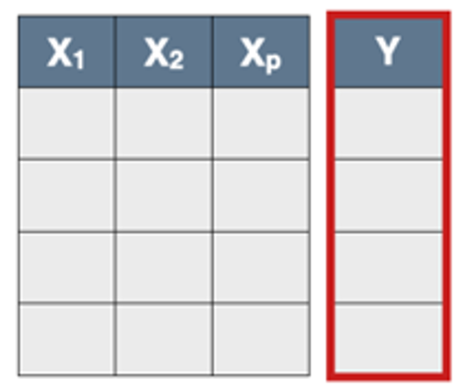
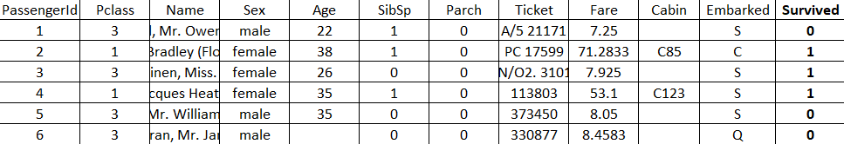
Input of machine learning methods
feature
label
Sample
Example: Titanic disaster on Kaggle
Notes:
https://www.kaggle.com/c/titanic/overview
https://dinhanhthi.com/titanic-disaster/

Slide 7
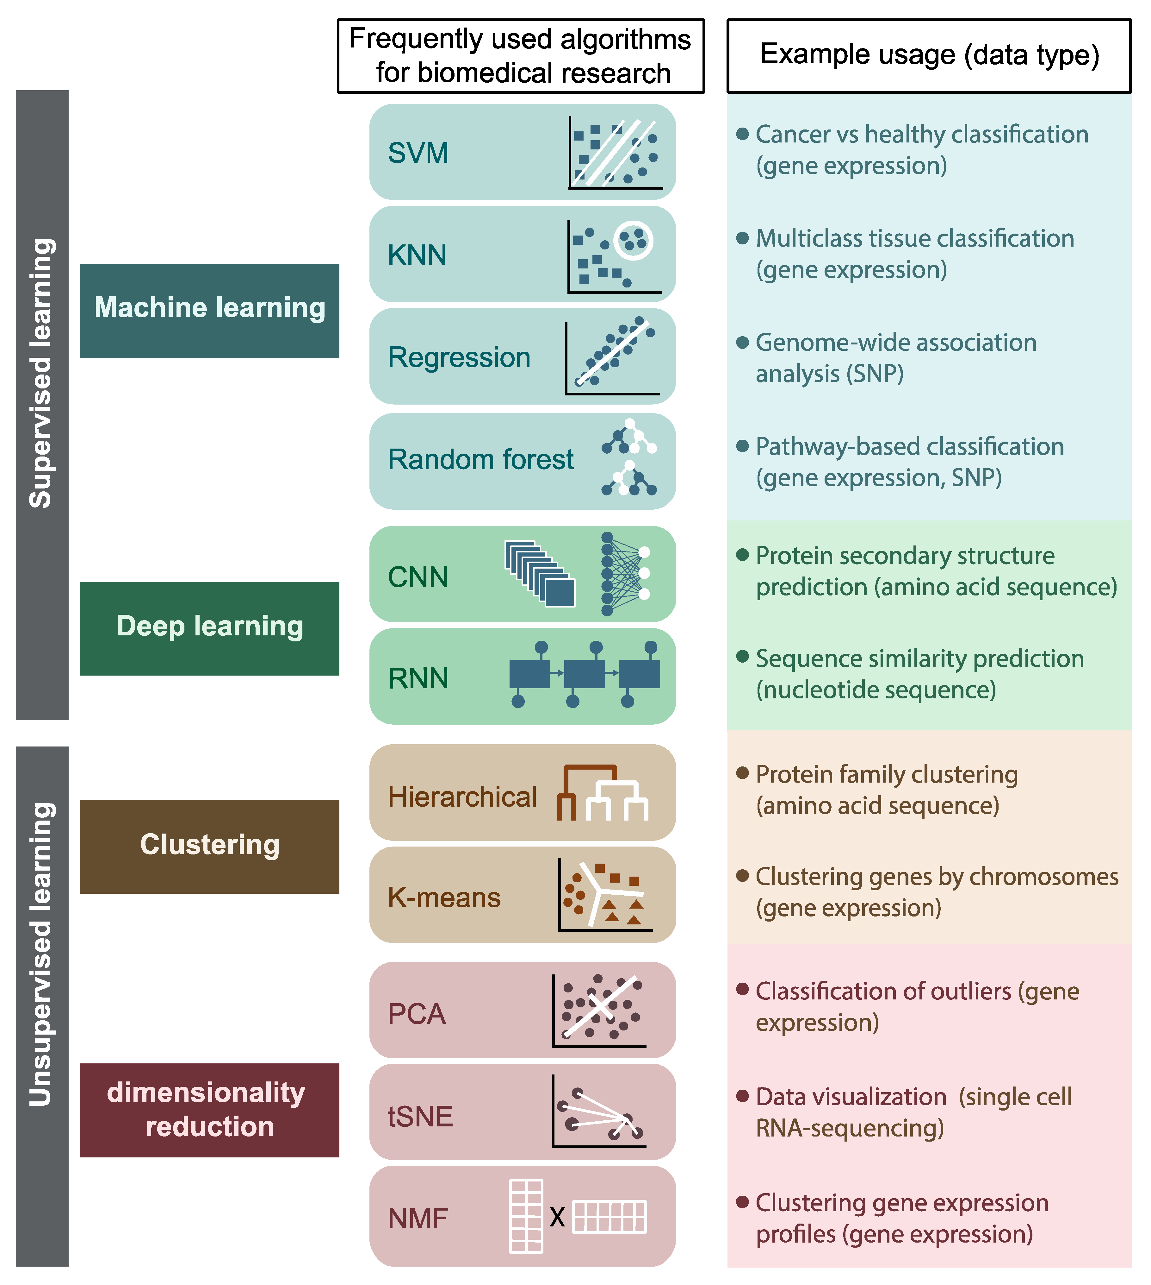
Top used algorithms in biological data analysis

Slide 8
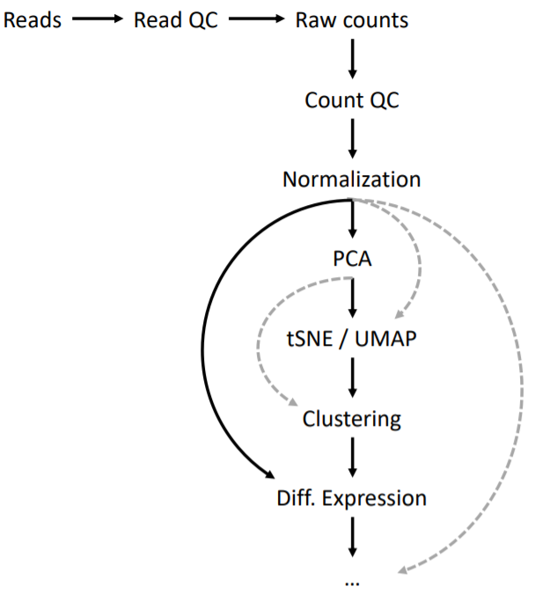
When we are dealing with multi-samples
A general single cell analysis workflow

Slide 9

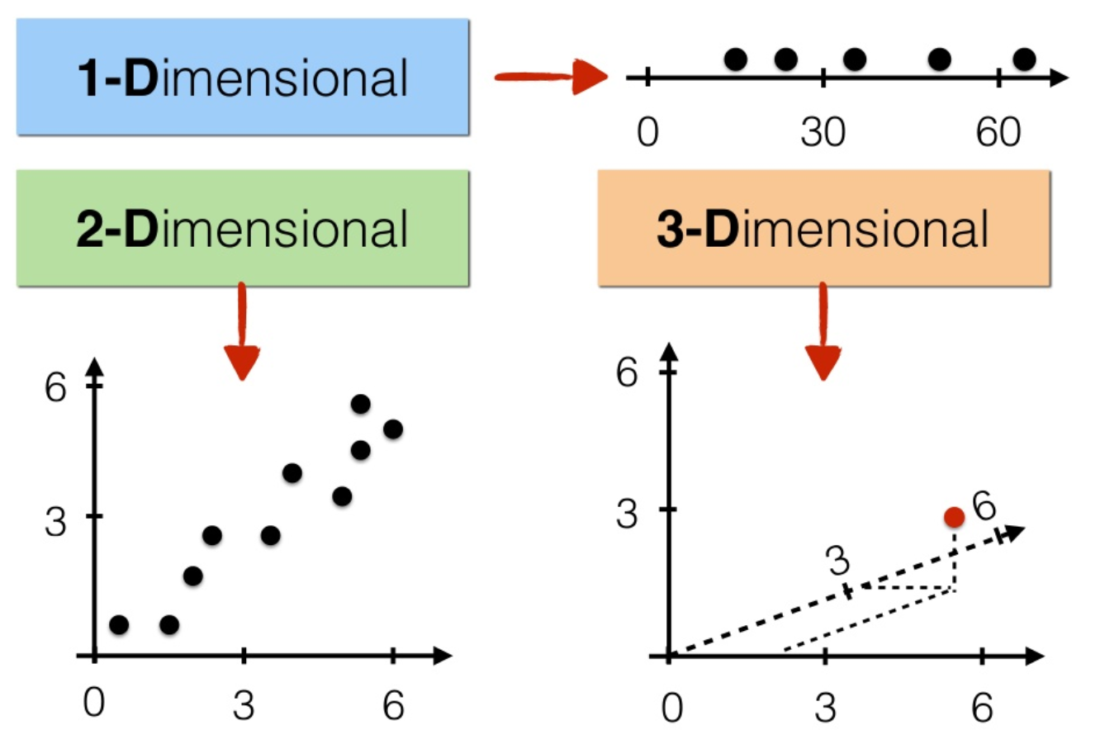
What is dimension?
feature (genes)
no label
Sample
(cell)
Notes:
Embedding/

Slide 10
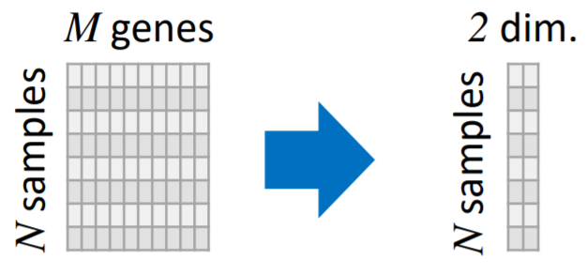
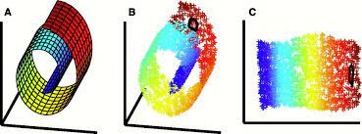
What is dimension reduction?
feature (genes)
no label
Sample
(cell)
sampling
dimension reduction
dimension: p
3D
2D
Aim: low-dimensional representation retains meaningful properties of the original data, ideally close to its intrinsic dimension.
- i.e. distances are preserved as well as possible
Notes:
Embedding/

Slide 11
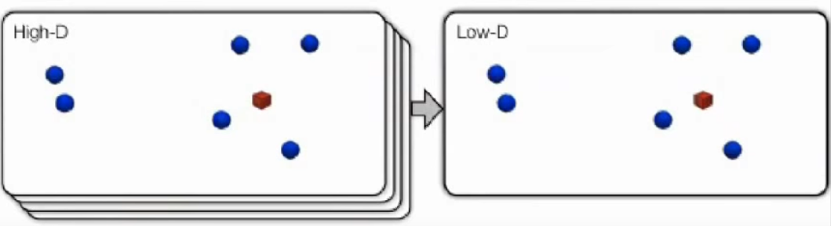
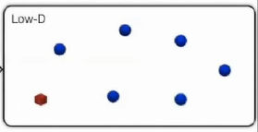
What is dimension reduction?
Build a low dimension map in which distances between samples reflecting similarity in high dimension
Minimize some objective function that measure the difference between similarity in high dimension and low dimension

Slide 12
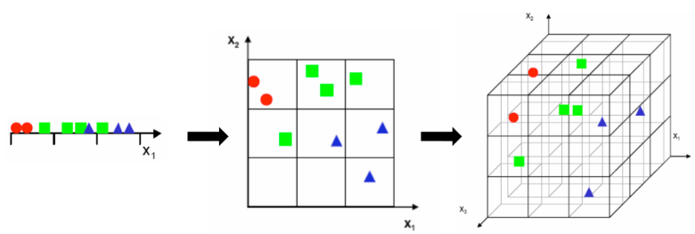
Why we need dimension reduction?
Curse of dimensionality
Statistics need repetition!
1. Remove redundant and irrelevant features, captures the “essence” of the data.
2. Simpler to compute and analytically tractable. （clustering）
3. Visualize high dimensional data. (2D;3D)
Notes:
1.各种机器学习算法难以处理高维度的数据
2.数据本身具有其本征维度，很多相关的维度是冗余的，因此我们需要进行降维

Slide 13
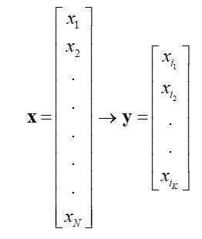
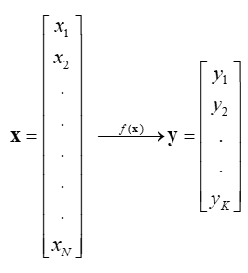
What is dimension reduction?
Feature selection: chooses a subset of the original features.
Feature extraction: finds a set of new features (i.e., through some mapping f()) from the existing features
K<<N
K<<N
The mapping f() could be linear or non-linear

Slide 14
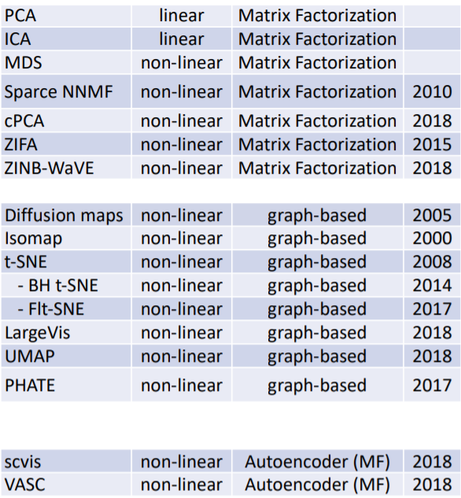
Dimension reduction methods
1901
PCA: Seek a projection preserving as much as information in the low-dimension.
ICA: Making features as independent as possible.
t-SNE: Distance in low dimension between samples reflecting similarities in high dimension
Isomap, UMAP: Finding the low dimensional manifold

Slide 15

PCA: principle component analysis
Seek a linear projection preserving as much as information in the low-dimension.
gene2
gene2
c²=a²+b²
PC1
gene2
PC2
b
a
c
gene1
gene1
gene1
maximizing variance=minimizes the squared error
Notes:
1.按重要性从大到小排列的新特征，2.它们是原来特征的线性组合，相互之间不相关

Slide 16
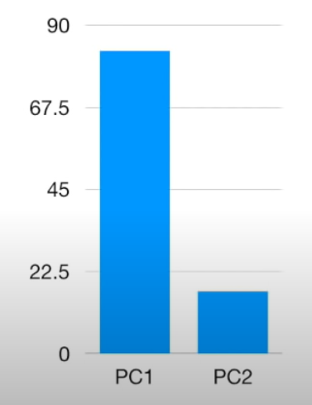
PCA: principle component analysis
Scree plot
gene2
c²=a²+b²
PC2 （17%）
eigen vector
PC1
PC2
a
b
PC1 （83%）
gene1
c
Loading scores : PC1 direction takes
3 (0.95) part of gene1 and
1 (0.32) part of gene2.
(a₁² +a₂² +a₃² +a₄² +a₅²+a₆² )/(n-1)=Variation for PC1
(b₁² +b₂² +b₃² +b₄² +b₅²+b₆² )/(n-1)=Variation for PC2
An eigen-decomposition of the covariance matrix of X.
or singular value decomposition (SVD) of the data matrix X.
Notes:
1.按重要性从大到小排列的新特征，2.它们是原来特征的线性组合，相互之间不相关
https://stats.stackexchange.com/questions/134282/relationship-between-svd-and-pca-how-to-use-svd-to-perform-pca

Slide 17
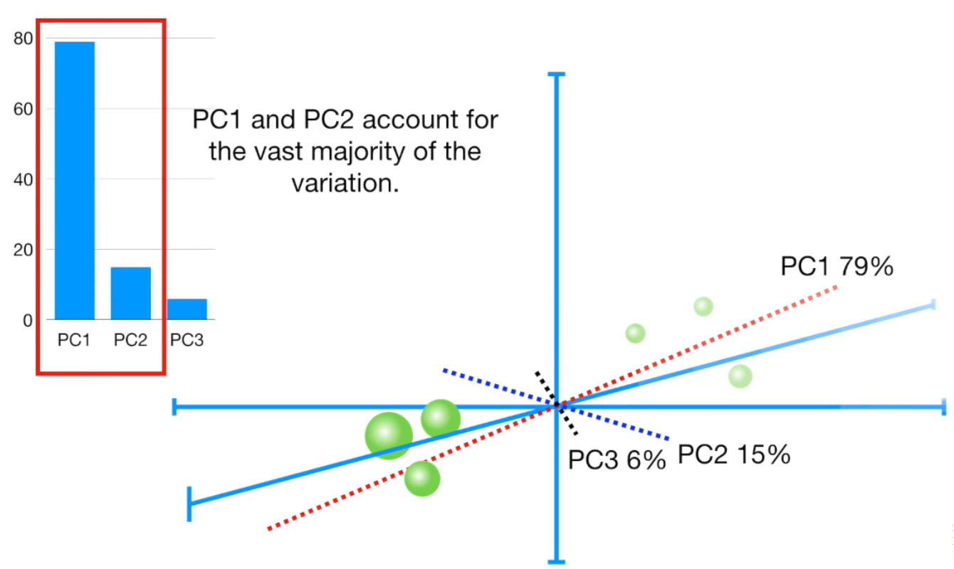
PCA: principle component analysis
Notes:
1.按重要性从大到小排列的新特征，2.它们是原来特征的线性组合，相互之间不相关

Slide 18
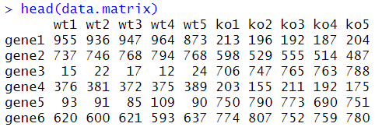
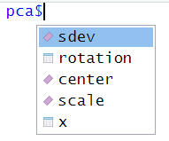
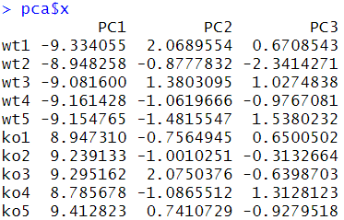
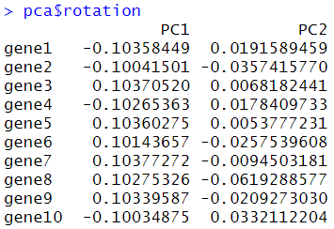
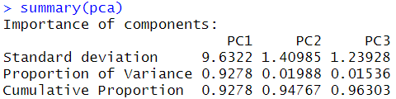
PCA in R
PCA implementation prcomp & sklearn.decomposition.PCA & Seurat
pca <- prcomp(t(data.matrix), scale=TRUE)
https://github.com/StatQuest/pca_demo/blob/master/pca_demo.R
Notes:
1.按重要性从大到小排列的新特征，2.它们是原来特征的线性组合，相互之间不相关

Slide 19
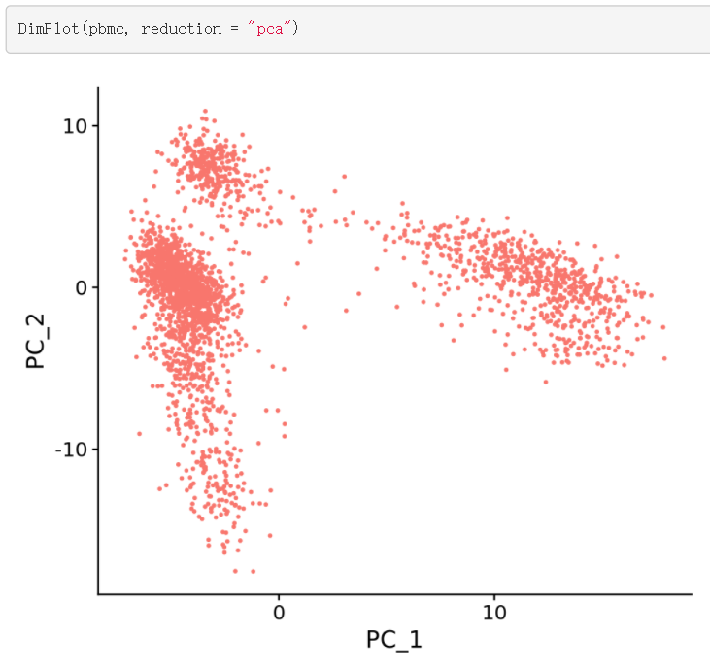
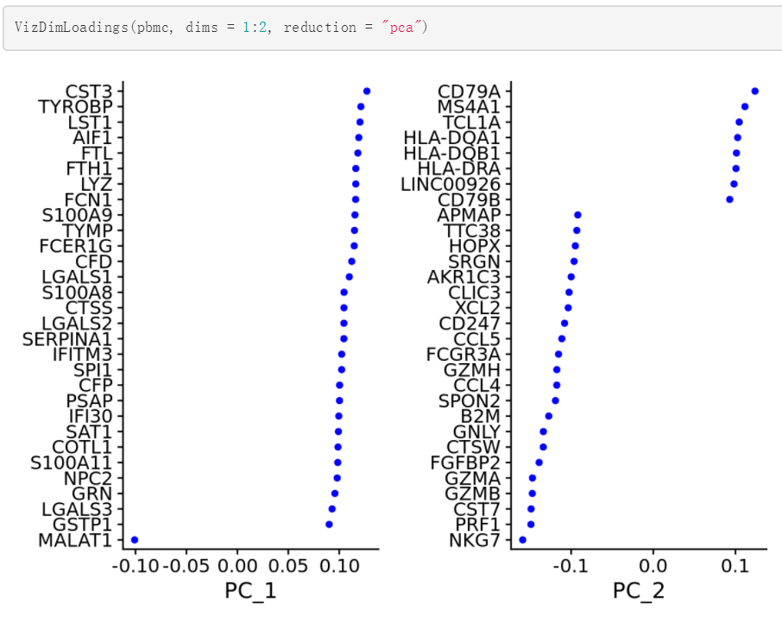
PCA in single cell RNA-seq data
Seurat - Guided Clustering Tutorial
Notes:
1.按重要性从大到小排列的新特征，2.它们是原来特征的线性组合，相互之间不相关

Slide 20
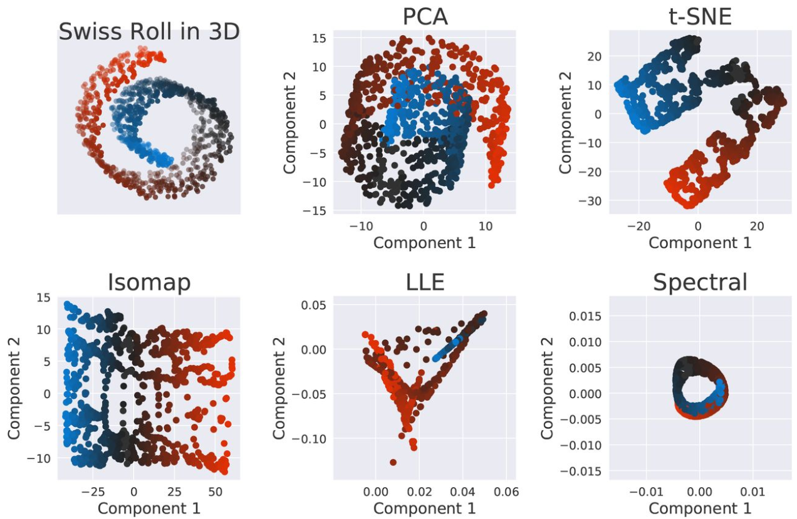
PCA applied at Swiss Roll dataset
Notes:
1.按重要性从大到小排列的新特征，2.它们是原来特征的线性组合，相互之间不相关

Slide 21
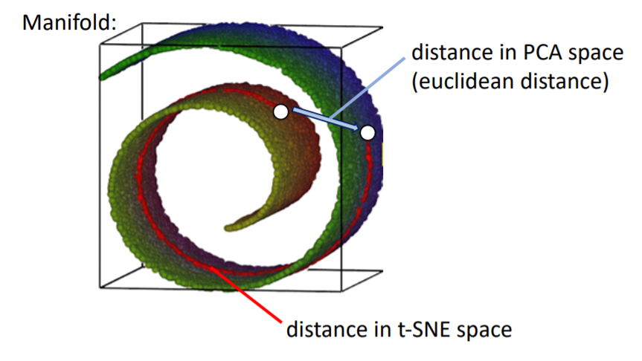
tSNE: t-distributed stochastic neighbor embedding
It is a graph-based NON-LINEAR dimensionality reduction
PCA preserves the large pairwise distances in the map.
tSNE preserves small pairwise distance
Notes:
1.按重要性从大到小排列的新特征，2.它们是原来特征的线性组合，相互之间不相关

Slide 22
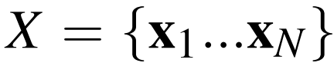
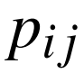
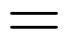
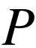
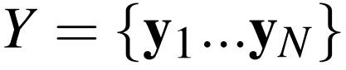
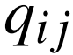

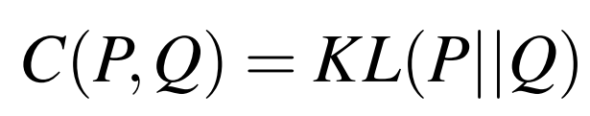
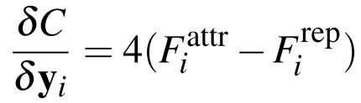
How t-SNE works
Similarity between i and j in H-Dim
Probability distribution encoding similarities
Similarity between i and j in L-Dim
High-Dimensional Space
Low-Dimensional Space
Probability distribution encoding similarities
Similarity Computation
Embedding Optimization
Entropy-based cost function

Slide 23
How t-SNE works
Similarity between i and j in H-Dim
Probability distribution encoding similarities
Similarity between i and j in L-Dim
High-Dimensional Space
Low-Dimensional Space
Probability distribution encoding similarities
Similarity Computation
Embedding Optimization
Entropy-based cost function

Slide 24
How t-SNE works
Similarity between i and j in H-Dim
Probability distribution encoding similarities
Similarity between i and j in L-Dim
High-Dimensional Space
Low-Dimensional Space
Probability distribution encoding similarities
Similarity Computation
Embedding Optimization
Entropy-based cost function

Slide 25
How t-SNE works
Similarity between i and j in H-Dim
Probability distribution encoding similarities
Similarity between i and j in L-Dim
High-Dimensional Space
Low-Dimensional Space
Probability distribution encoding similarities
Similarity Computation
Embedding Optimization
Entropy-based cost function

Slide 26
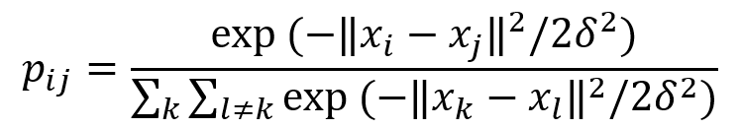
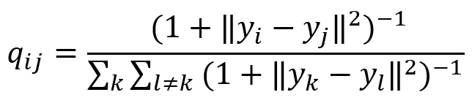
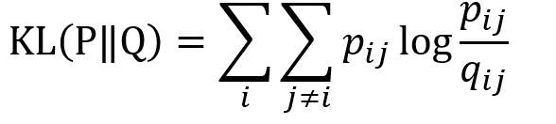

How t-SNE works
Similarity between i and j in H-Dim
Probability distribution encoding similarities
Similarity between i and j in L-Dim
Probability distribution encoding similarities
Entropy-based cost function
Large modeled by small ? Big penalty!
Small modeled by large ? Small penalty!
Hence, t-SNE mainly preserve local similarity structure.

Slide 27
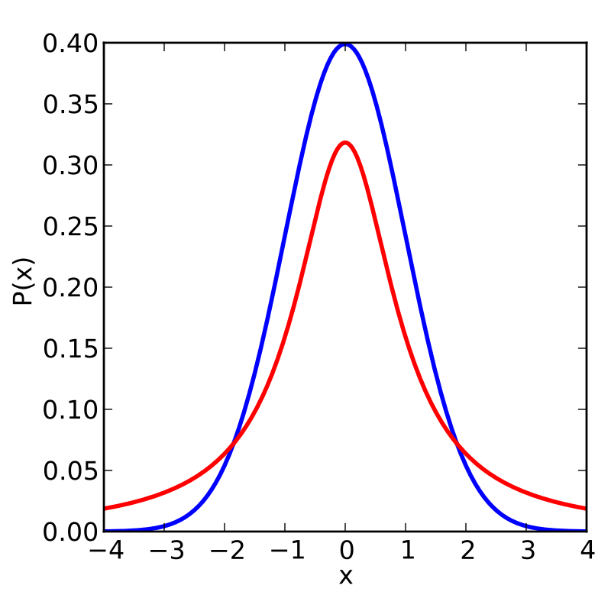
Why a Student-t distribution
Dissimilar points should be modeled far apart in low dimension.
Avoiding crowd problem
Student's t
Gaussian
2D
1D

Slide 28
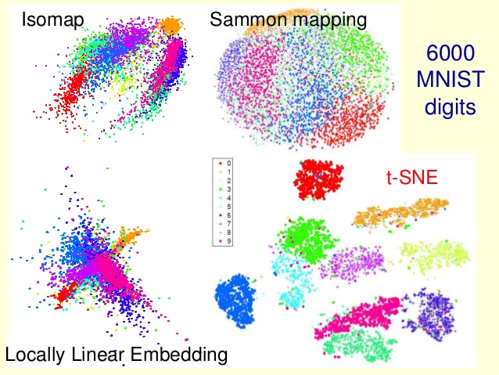
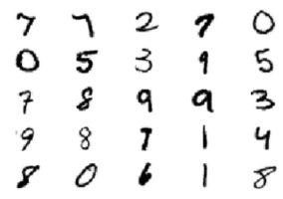
t-SNE on MNIST digits

Slide 29
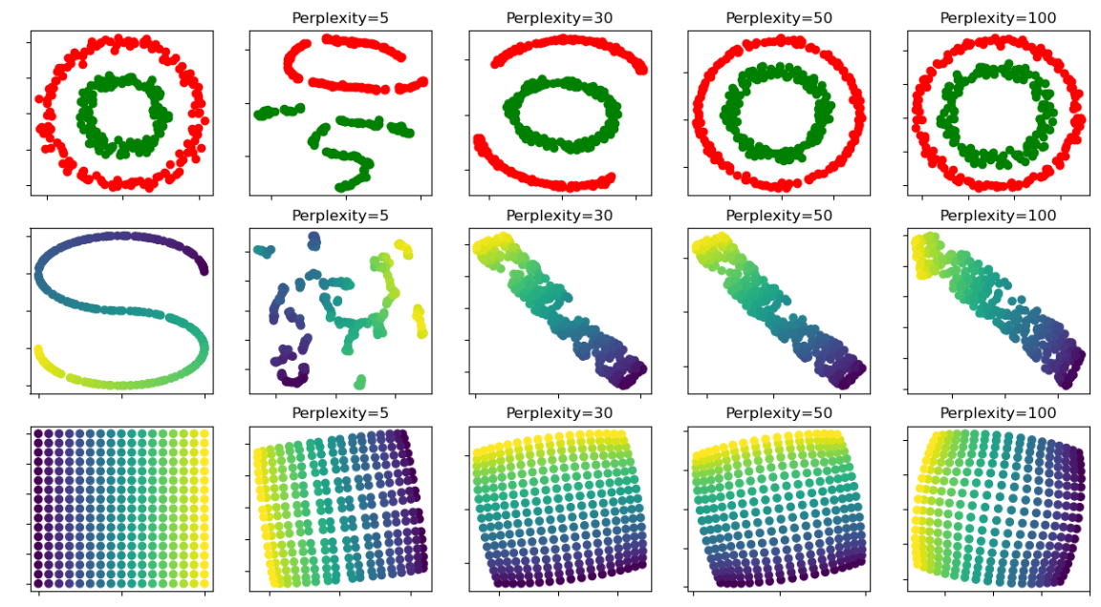
t-SNE on two concentric circles and the S-curve

Slide 30
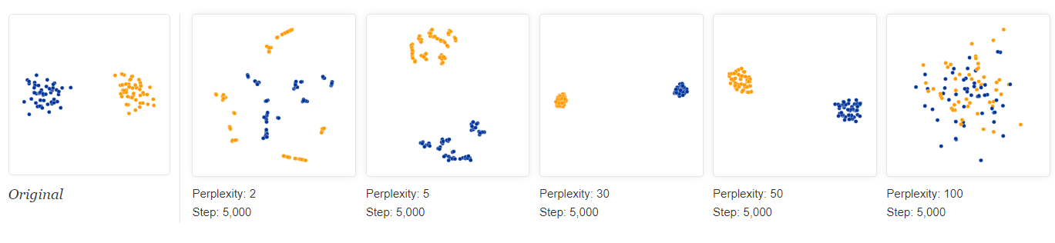


How to Use t-SNE Effectively
Perplexity (hyperparameters) really matter
Local
Golobal
Not suitable
t-SNE captures local structures with low Perplexity
https://distill.pub/2016/misread-tsne/

Slide 31


How to Use t-SNE Effectively
Distances between clusters might not mean anything
Cluster sizes in a t-SNE plot mean nothing
https://distill.pub/2016/misread-tsne/
Notes:
t-SNE算法具有扩展密集簇并缩小稀疏簇的特点

Slide 32
Important notes about t-SNE
tSNE implementation - O(n log n) Rtsne & sklearn.manifold.TSNE & Seurat
2. It can be run from the top PCs (e.g.: PC1 to PC10)
3. Unlike PCA, it is a stochastic algorithm, so it will never produce the same output (unless you use a seed() to lock the random estimators).
4. To add more samples, you need to re-run the algorithm from start.

Slide 33



tSNE in R
Notes:
鸢尾花

Slide 34

Umap: uniform manifold approximation and projection
It is based on topological structures in multidimensional space (simplices)
UMAP has strong theoretical foundations.
Low dimensional simplices
A large class of topological spaces can be constructed by gluing together simplices of various dimensions along their faces. (Nerve theorem)
Notes:
模糊单纯复形 fuzzy simplicial complex

Slide 35

How to represent data with simplices
Test data set of a noisy sine wave
Notes:
模糊单纯复形 fuzzy simplicial complex

Slide 36

How to represent data with simplices
A basic open cover of the test data.
Notes:
模糊单纯复形 fuzzy simplicial complex

Slide 37

How to represent data with simplices
A simplicial complex built from the test data
Notes:
模糊单纯复形 fuzzy simplicial complex

Slide 38

Adapting topological analysis to real world data
Open balls over uniformly distributed data
Notes:
模糊单纯复形 fuzzy simplicial complex

Slide 39

Adapting topological analysis to real world data
Open balls of radius one with a locally varying metric
A unit ball about a point in Riemannian space stretches to the k-th nearest neighbor of the point.
Notes:
模糊单纯复形 fuzzy simplicial complex

Slide 40

Adapting topological analysis to real world data
Fuzzy open balls of radius one with a locally varying metric
Notes:
模糊单纯复形 fuzzy simplicial complex

Slide 41

Adapting topological analysis to real world data
Graph with combined edge weights
All these stuff give us a good Pij in high dimension.
Notes:
模糊单纯复形 fuzzy simplicial complex

Slide 42


How Umap works
Riemannian space
Similarity between i and j in H-Dim
Probability distribution encoding similarities
Euclidean space
Similarity between i and j in L-Dim
Probability distribution encoding similarities
Large modeled by small ? Big penalty!
Cross entropy-based cost function
Small modeled by large ? Big penalty!
Umap could preserve local and global similarity structure.

Slide 43



Hyper-parameters of Umap
neighbors: number of nearest neighbors.
Notes:
模糊单纯复形 fuzzy simplicial complex

Slide 44



Hyper-parameters of Umap
neighbors: number of nearest neighbors.
min_dist: determines how close points appear in the final layout.
https://pair-code.github.io/understanding-umap/
Notes:
n_neighbors:这决定了流形结构局部逼近中相邻点的个数。更大的值将导致更多的全局结构被保留，而失去了详细的局部结构。一般来说，这个参数应该在5到50之间，10到15是一个合理的默认值。
min_dist: 这控制了嵌入的紧密程度，允许压缩点在一起。数值越大，嵌入点分布越均匀;数值越小，算法对局部结构的优化越精确。合理的值在0.001到0.5之间，0.1是合理的默认值。

Slide 45

Umap on MNIST and Fashion MNIST
Notes:
模糊单纯复形 fuzzy simplicial complex

Slide 46


UMAP vs t-SNE
broad cell lineages
tissue of origin
Becht et al. Nature Biotechnology. 2018

Slide 47

Umap is really fast
Notes:
模糊单纯复形 fuzzy simplicial complex

Slide 48
Important notes about Umap
Umap implementation - O(n) umap & umap.UMAP() & Seurat
2. It can be run from the top PCs (e.g.: PC1 to PC10)
3. It is no longer completely stochastic as t-SNE
4. Can be applied to new data points
5. Defines both LOCAL and GLOBAL distances

Slide 49



Umap in R
Original data embedding
New data embedding

Slide 50


Develop new dimension reduction methods
Li et al. NAR. 2017
Wang et al. GPB. 2018

Slide 51
Recommendation
StatQuest with Josh Starmer
https://www.youtube.com/c/joshstarmer/playlists
Coursera class - Machine Learning (Andrew Ng)
https://www.coursera.org/learn/machine-learning
Dimension reduction
https://www.analyticsvidhya.com/blog/2018/08/dimensionality-reduction-techniques-python/
Single cell
1. Seurat - Guided Clustering Tutorial
https://satijalab.org/seurat/articles/pbmc3k_tutorial.html
2. Single cell RNA-seq data analysis with R
https://www.csc.fi/web/training/-/scrnaseq
Notes:
https://www.youtube.com/c/joshstarmer/playlists
https://www.coursera.org/learn/machine-learning
https://github.com/StatQuest
https://scikit-learn.org/stable/

Slide 52
Thanks for your attention

Slide 53


Slide 54


Slide 55


Slide 56


Slide 57


Slide 58


